Slide 1

(An Autonomous Institution) Coimbatore-642109
DEPARTMENT OF COMPUTER SCIENCE AND ENGINEERING POJECT REVIEW - II
SOFTWARE QUALITY ANALYTICS AND RISK
ASSESSMENT USING CLOUD-BASED MACHINE LEARNING
Guided by
Dr. Jamuna R
Presented By
Prasannaram R R ([redacted])
Professor,
Department of Computer Science and Engineering

Slide 2
ABSTRACT
Software defects reduce reliability and increase maintenance costs, while traditional
testing methods often identify issues only in the later stages of development.
This leads to delays in fixing errors, increased project expenses, and reduced overall efficiency.
As software systems become more complex, manually detecting defects becomes difficult and time-consuming for developers and testers. To overcome these challenges, the proposed
system uses cloud-based machine learning techniques to analyze historical software metrics and predict defect-prone modules at an early stage.

Slide 3
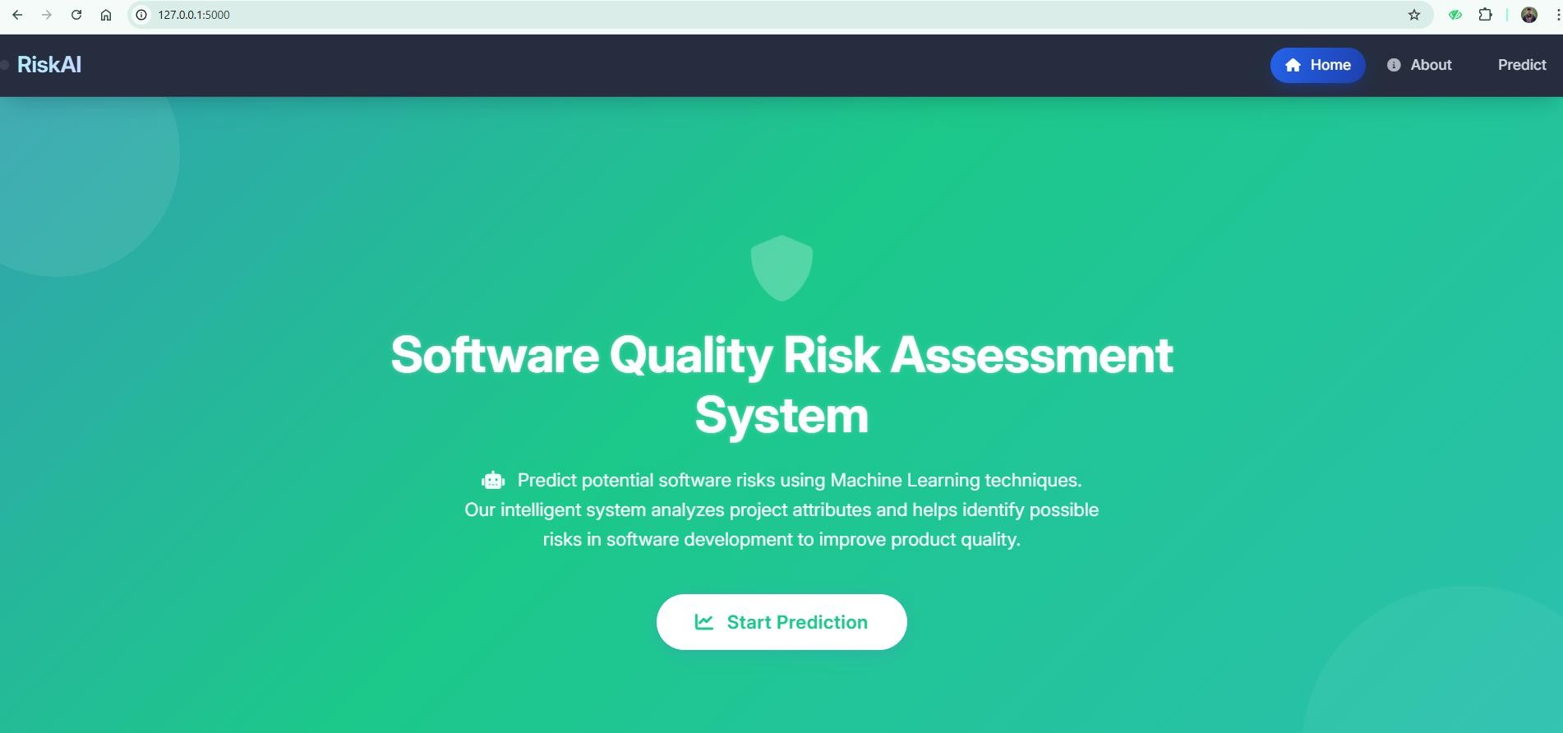
50% Work Progress of the Project

Slide 4
Remaining Work (Next 50%)
Integration of advanced machine learning enhancements and optimization
Final testing and performance evaluation of the complete system
Implementation of confusion matrix and feature importance analysis
Deployment and scalability improvements using cloud/web technologies
Enhancement of user interface and graphical dashboard visualization
Addition of error handling, validation, and security features
Preparation of final documentation, report formatting, and references
Development of future enhancement modules and analytics features
Final review, debugging, and system performance tuning
Completion of PPT presentation, result screenshots, and project demonstration

Slide 5
LOGIC EXPLANATION
Collect software metrics such as CBO, WMC, RFC, LCOM, and LOC
Preprocess and clean the dataset by removing invalid values
Select important features required for prediction analysis
Assign risk labels as Low, Medium, or High based on conditions
Train the Random Forest model using historical software data
Accept new user input through the web interface
Predict software risk level using the trained model
Display prediction result along with graphical visualization
Analyze prediction probabilities for better decision-making
Generate final output for software quality assessment

Slide 6
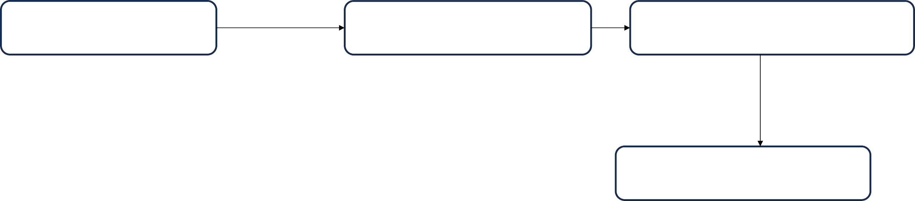
ALGORITHM
1. Data Collection
Collect software metrics and defect datasets from repositories & Source
2. Data Preprocessing
Clean and normalize the dataset by handling missing and invalid values.
3. Feature Engineering Select important features and apply dimensionality reduction techniques.
5. Risk Prediction
Predict software defect probability using the trained model.
4. Random Forest Model Training
Train the Random Forest model using processed software metrics.
6. Risk Classification Classify the software module into High, Medium, or Low risk
categories.
7. Quality Analytics Dashboard Display prediction results and graphical analytics for decision-
making.

Slide 7
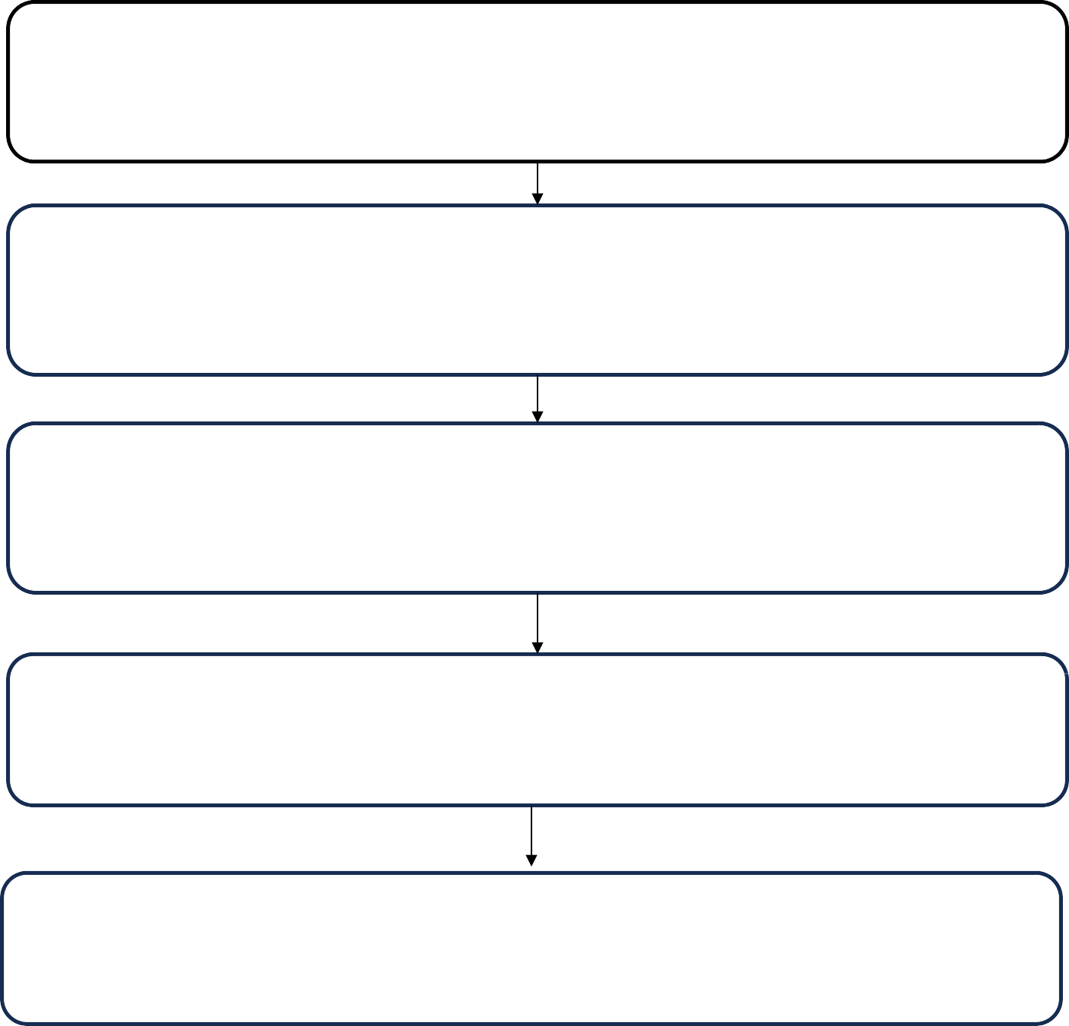
Tools
Machine Learning Framework
(Random Forest and Scikit-learn used for prediction model building)
Web Development
(Flask framework used for backend and web application development)
Frontend Design
(HTML, CSS, Bootstrap, and JavaScript used for user interface design)
Data Processing
(Pandas and NumPy used for data cleaning and manipulation)
Data Visualization
(Matplotlib and Chart.js used for graphical result visualization)

Slide 8
PROGRAMMING LANGUAGES
Python
(Main backend, AI )
HTML
(Frontend Dashboard )
CSS
(Frontend Styling and Layout)
JavaScript
(Frontend interactivity,UI behaviour and client-slide calls)

Slide 9
CONCLUSION
The proposed system successfully predicts software risk levels using machine learning techniques and software metrics. By applying the Random Forest algorithm, the system classifies software modules into Low, Medium, and High risk categories with good accuracy. The project helps developers identify potential defects at an early stage, reducing maintenance cost and improving software quality.
The integration of a Flask-based web application makes the system user-friendly and efficient for real-time prediction and analysis. Graphical visualization and analytics further improve decision-making and understanding of software risks. Overall, the project provides an effective, scalable, and intelligent solution for software quality analytics and risk prediction.

Slide 10
Thank You

